Slide 1
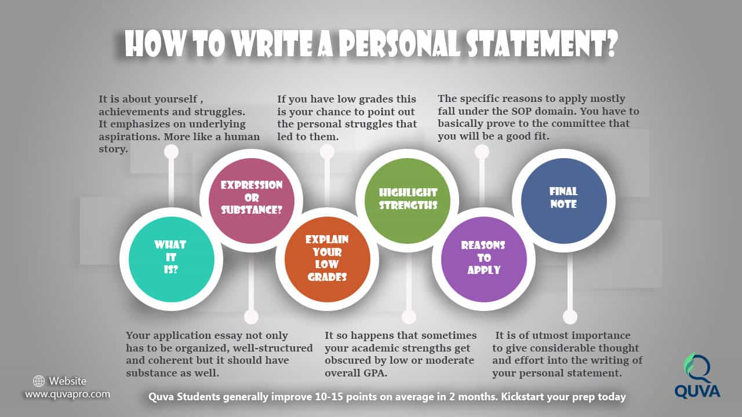
PERSONAL STATEMENT

Slide 2
PERSONAL STATEMENT
A personal statement is:
A picture. Your personal essay should produce a picture of you as a person, a student, a potential scholarship winner, and a change maker after scholarship recipient.
An invitation. The reader must be invited to get to know you, personally. Bridge the assumed distance of strangers. Make your reader welcome.
• An indication of your priorities and judgement. Tell the committee what your priorities are.
• A story, or more precisely, your story. Be a natural storyteller. Be unique and know your life`s inherent drama. Do serious self-reflection, conversation with friends, family, and mentors, and be creative.

Slide 3
WHAT NOT IS A PERSONAL STATEMENT.
A personal statement is not:
An academic paper. P.S. is subjective. Your goal is to close the distance between you and the reader in the P.S.
A resume in narrative form. Resume like list of accomplishments and goals reveals little about the candidate. It`s a wasted opportunity.
A journal entry. Mention your relevant experiences or personal observations that you are confident with. Your P.S. should not read like a diary.

Slide 4
Why a personal statement is written?
Graduate admissions committees use personal statements to learn more about an applicant, what interests them about the program, and what they can contribute in terms of research, conferences and other collaborative opportunities.

Slide 5
Prompt types.
General: May have a word or character count, with a generic prompt such as “Write a personal statement describing your experiences and goals.”
Specific: This prompt often includes several questions such as, “Explain why this program is the best fit for you” or “Tell us about an accomplishment that is important to you.”

Slide 6
PREP WORK
Before you begin, gather information such as transcripts, resume and application.
Brainstorm information to include in your essay: names of past supervisors, applicable job titles, experiences, past successes, observations, dreams, aims, struggles, job skills and personal traits you want to specifically communicate.
Having this at your fingertips will make the overall writing process easier.

Slide 7
What to include in the personal statement?
The personal statement is a way to sell your abilities. An effective personal statement will answer the following questions:
Who am I?
Who do I want to be?
What interests and qualifications make me the right applicant for this program?
• What kind of contribution do I want to make, and how?
• Why am I pursuing a career in this field? Why does it make sense for me to study at XYZ college or university?

Slide 8
THE STRUCTURE OF YOUR STATEMENT
Personal statements are personal, there is no one type or style of writing that is set out as a model; however, its purpose is the same.
First section | 20% | Your choice of subject to study at university
Second section | 70% | The subjects you are currently studying, your extracurricular interests and achievements.
Third section | 10% | tie-in how this position is a step towards a long-term goal
You need to have evidence to support your claims, so think about what evidence you might provide.

Slide 9
First section: Introduction- your choice of subject
Grab the reviewer’s attention with a catchy opening, such as a distinctive personal example.
Then, connect the example to the program/position for which you are applying.
Mention the specific name of the program or company, as well as the title of the position or degree you are seeking.
Mention any relevant work experience, summer employment or voluntary work that supports your application.
USE THE A.R.C. MODAL
Activity: what have you read, watched or done, interested that inspired you?
Reflection: Why did it inspire you? What did you find out? What questions did it make you ask?
Course: How did it develop your interest in the subject you are applying to study?

Slide 10
Second section: the subjects you are currently studying
Answer the following questions.
Why have you chosen to read the subject at university?
What is the background to your interest in the subject? Any wider readings?
For how long have you had this interest and What particular areas of your studies appeal most and why?
Why you are the most suitable candidate?
Have you spent any time on a residential course run by a university?
What did you learn?
How useful were the courses?
6. What are your career aspirations?

Slide 11
Second section: the subjects you are currently studying
Paragraphs should address specific questions from the application.
Each paragraph should be focused and support a topic sentence.
Keep your examples relevant to your qualifications.
Mention all of your subjects and briefly explain which parts of the course you have found most interesting and why.
Provide the evidence of wider reading or experience beyond the syllabus directly relevant to your chosen subject?

Slide 12
Second section: A crucial part.
Many applicants simply do not read anything beyond their textbooks.
You should name books, articles or media events that have inspired or challenged you, and be able to explain why.
If you are likely to be called for interview, be prepared to discuss some of the references at length. In other words – do not lie!
Expand on just a few experiences.
Use ARC format: describe an ACTIVITY in detail; critically REFLECT on the experience; relate the experience to your chosen university COURSE.

Slide 13
Third section: your extracurricular pursuits and skills
Focus particularly on your extracurricular pursuits (both in and out of school or college). You can also emphasize important skills you possess,
such as leadership, initiative and personal skills.
give evidence of the following areas.
Extracurricular subjects: what subjects are you studying outside the curriculum?
Other achievements: these achievements should be substantive and show that you are both able and dedicated. High grades in music or drama exams and Scout awards are all worthy examples.
Leadership potential: give evidence of your leadership potential, how
you were selected (elected?) and what you learned from leading your
team.

Slide 14
Third section: your extracurricular pursuits and skills
Inside school: have you held positions of significant responsibility, for example head boy or girl, house captain or prefect, chair of the student council, debating society, enterprise teams, Target 2.5 interest rate challenge, or sports captain.
Outside school: local political party work, charity work, church choir, uniformed organisation, young church leader, non-school sporting achievement.
Other successes: details of signifi cant other successes you have enjoyed – these may include community or charity work, for example, running the London Marathon, or anything else that sets you apart from the couch potatoes with their eyes glued to Sky or the latest PS3 game!
Gap year: mention any gap year plans you have, accentuating the positive advantages of such a gap year for your future vocation. Most universities are happy to offer you a deferred place but Oxbridge tends
not to encourage deferred applications for mathematicians and that is also true of other major universities. This is something to research and consider carefully before you fi ll in your UCAS form.

Slide 15
Conclusion
In the last paragraph tie together any examples you sited, and restate your interest in the program or position. Finishing statement can tie-in how this position is a step towards a long-term goal.

Slide 16
EDITING
A good Personal Statement will probably take three weeks to write. So do not
leave it to the last minute
Allow for several edits and ample proofreading. Check for proper content and for technical errors.
Read through the essay yourself (out-loud helps) and have others (Career Services, professors, parents,
etc.) review it as well.

Slide 17
EDITING- STATEMENT CHECKLIST
• Spelling and grammar have been checked
• Single-spaced and printed on one side of paper
• Two spaces between each paragraph and the content is positioned on the page well
• All lines start on the left-hand side of the page
• The opening paragraph is engaging
• Reflects genuine interest and enthusiasm in the kind of work to be done
• Overall positive tone.

Slide 18
WRITING TIPS
Answer the Question: Do not spend the entire letter talking about your qualifications. Instead, talk about what attracted you to the company or program.
Consider The “I” Problem: This letter is about you. It is okay to use first person; however, do not start every sentence with “I.”
Avoid Duplication: Do not reiterate, rather be general, if needed. For example: “I was on the Dean’s List” and then move on to discuss other experiences.
Make Your Statement Standout: Include at least one detailed example specific to your own experience. For example, describe how a family member or personal moment influenced your career or degree decisions.
Keep It Brief: 250–500 words. Statements should be concise, clear and detailed. Per paragraph single idea. Use a thesaurus and repetition but avoid unfamiliar vocabulary.

Slide 19
Remember the goal:
Grab the readers’ interest, and make them want to meet you for an interview.
Get a sense of the experiences and dreams you wish to share, then examine them for a helpful means of making sense of it all.
You will find your story; and if you share it honestly, you will have written a personal statement.
Finally, know that writing a personal statement is hard and will take many drafts and much reflection.
Don’t wait until you have it right to share it with others; their input will likely make it stronger, clearer, and tighter.
Don’t put it off until you have it right … just write!

Slide 20
DO…
• Allow plenty of time to brainstorm and
rewrite your essays
• Take time to think about who you are and
the experiences that have shaped your life
• Look at this as an opportunity to tell
admissions committees about you, and go
beyond the facts that are conveyed by
other parts in the application
• Tailor and adapt an essay for each specific
program you are applying to, unless it is to
be submitted to multiple schools via a
centralized application service
• Mention possible career paths, interests,
professional goals, and explain why you are
ready for an advanced degree in this field
• Be specific; be sure to back up all
statements with examples and concrete
evidence
• Research your programs and schools. Ask
yourself if there are certain values expressed
in the program or aspects, such as a thesis,
that intrigue you
• Answer all parts of the prompt
• Stay within the word or character count
• Frequently save your document in multiple
locations

Slide 21
DON’T...
• Take any political or religious viewpoints unless relevant
• Sound defensive or arrogant- Tone is key
• Be cliché or use generalizations
• Write in the third person. First person is
always best
• Make lists of accomplishments. Instead
elaborate on them with examples and
stories highlighting your skills and
experience
• Try to be funny or make jokes
• Start every sentence with I
• Include your hobbies/interests unless
relevant
• Use vocabulary you don't normally use and just looked up in a dictionary
• Use famous quotes
• Repeat things in your application
• Write a list of all your hobbies and
interests without explaining them
Lie or embellish the truth
• Say you are going to do something
before you come to university

